Slide 3
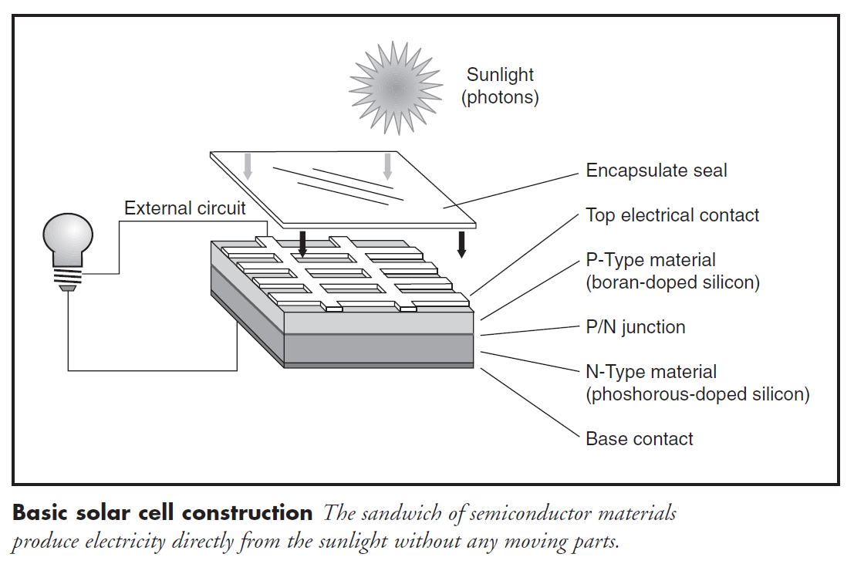

Slide 4
Photovoltaic module consists of:
Transparent front side
Encapsulated solar cells
Backside

Slide 6
Front side material (super-strate)
Low-iron, tempered glass
For some special module types some other front side materials are used like DuPont™ Tefzel® or non-tempered glass for example

Slide 7
International standards
Required mechanical characteristics (impact resistance etc.) and module qualification procedures

Slide 8
Backside
Usually non transparent
Most common used material is PVF (registered trade mark - Tedlar®)
Transparent back side materials are often used in modules that are integrated into buildings envelope (facade or roof), BIPV

Slide 9
Encapsulation Materials
Between glass and back side solar cells encapsulated with encapsulation material are placed.
Two most often used materials are EVA (ethylene-vinyl-acetate) and PVB (polyvinyl-butiral).
PVB is also used in safety windscreens in automotive industry. It is used as encapsulation material in transparent modules.
EVA is used for encapsulation of cells in standard modules.

Slide 10
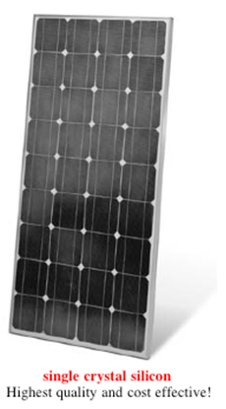

Slide 11
Technical data
The most important module parameters include:
Short circuit current
Open circuit voltage and a nominal voltage at 1000 W/m² solar radiation
Current and rated power at 1000 W/m²solar radiation value

Slide 12
Module parameters are measured at standard test conditions (STC)
Solar radiation 1000 W/m²
Air mass (AM) 1,5
Temperature 25ºC

Slide 13
Module datasheets
Peak power – W_{p}
Open circuit voltage – V_{oc}
Short circuit current – I_{sc}
Voltage at maximum power – V_{mp}
Current at maximum power – I_{mp}
Current at battery operating voltage – I
Nominal operating cell temperature (NOCT) - ºC
Wind loading of surface pressure - N/m² (km/h)
Impact resistance - mm at km/h
Maximum system voltage – V_{max}
Storage and operating temperature - ºC

Slide 14
Module efficiency
Commercial crystalline photovoltaic modules efficiency typically ranges from 10 to 13 %.
The solar cell efficiency doesn’t equal the module efficiency.
The module efficiency is usually 1 to 3 % lower than the solar cell efficiency.
Due to glass reflection, frame shadowing, higher temperatures etc.
Amorphous modules have the lowest price, yet their lifetime is short and their efficiency is up to 8 % only.

Slide 15
Temperature coefficients
All electrical parameters of solar module depends on temperature.
The most common temperature coefficients that are usually available in module data sheets are (typical values are valid for crystalline silicon solar cells):
α (I_{sc}) typical values between +0.03%/K and +0.1%/K
β (V_{oc}) typical values between -0.33%/K and -0.40%/K
γ (P_{mpp}) typical values between -0.40%/K and -0.50%/K
Values are important in design stage of PV system and they should be considered as important parameters related to the PV system design.

Slide 16
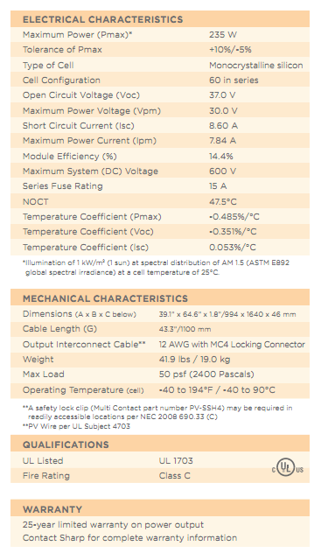

Slide 17
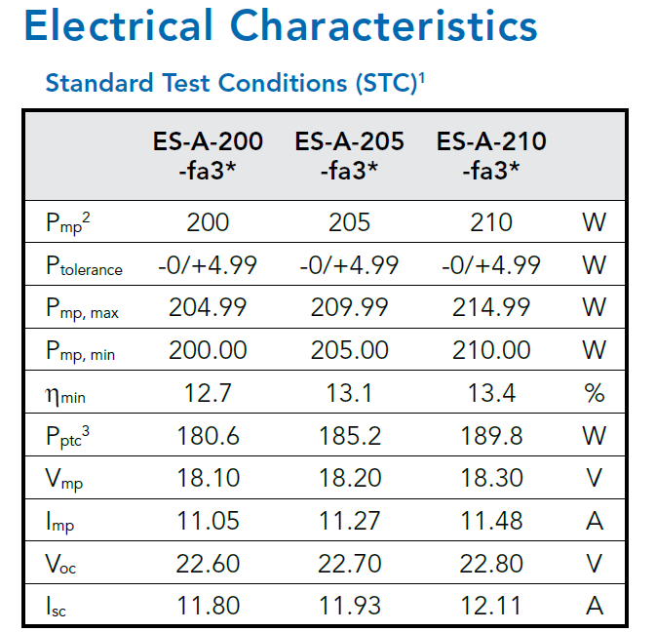

Slide 18
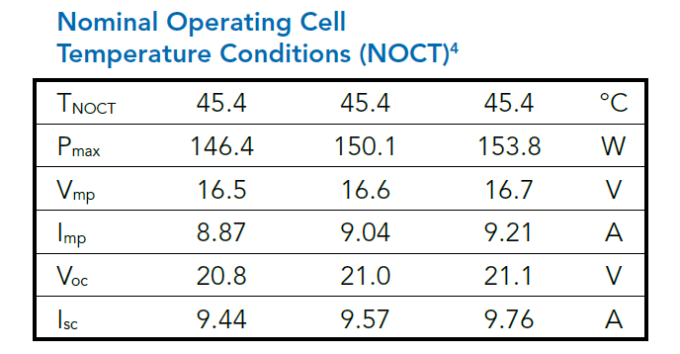
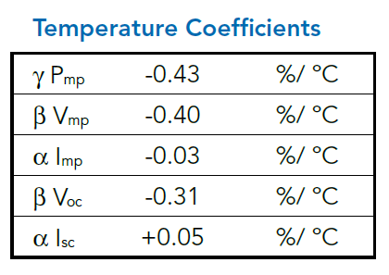

Slide 20
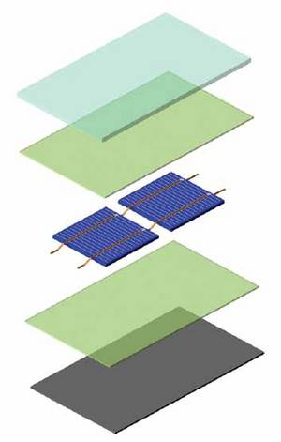

Slide 21
EVA Adhesive film Feature
Superior durability - 20 years resistance against weather, high temperature and high humidity
Excellent adhesion - 140 N/cm when applied to glass for TPT film.
>90% light transmission
Excellent encapsulating properties
Film is not adhesive at room temperature to ease manufacturing operations
Cross linking and enhanced bonding are achieved when the film is heated and pressed

Slide 22
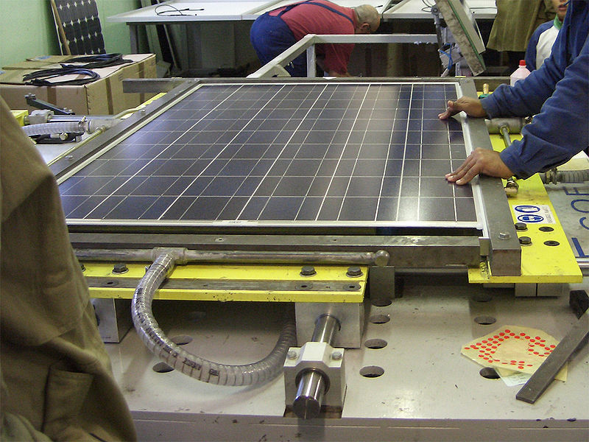
module lamination

Slide 23
Laminating Steps
Laminating: laminate the glass, EVA film, connected silicon cells, EVA film, TPT backsheet foil in sequence.
Vacuum pumping: Place above laminated pieces into the lower room of the double-vacuum press. Then the upper room and the lower room are vacuumed synchronously about 6min.
Heating: the upper room and the lower room are kept vacuum, meanwhile heat the laminated pieces.
Press: Laminated pieces are heated under 135°C-140°C conditions, the upper room cancel vacuum and get back to atmospheric pressure. At that time the lower room is still kept vacuum, that is to say, the upper room press on the laminated pieces of the lower room.
Curing: Isothermal curing under the curing temperature.
Cooling and framing: After isothermal curing, cancel the vacuum of the lower room, open the top of the press, and take out the laminated modules. Then cut off the extra EVA of composite lamination edge. Moreover seal frame and equip the termainal box, assemble PV modules at last.

Slide 24
Solar Cell Encapsulant TPT
1)UV resistance, Moisture barrier
2)Weatherability, Durability +25year
3)Electrical insulation
4)Inertness toward a wide variety of chemicals, solvents, and staining agents
5)Excellent adhesion to EVA, Waterproof.

Slide 25
Last Questions
Low- Iron Glass:
Low iron glasses have similar chemical composition and properties traditional glasses except the iron oxide content is significantly reduced, providing a less "greenish" tint.

Slide 26
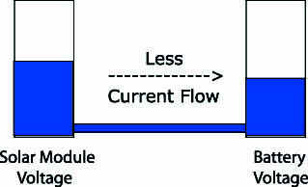
Current at battery operating voltage – I
As long as the pressure or voltage is higher in the solar module than in the battery, current will flow into the battery.
As the voltage or pressure in the solar module begins to fall due to increased air temperatures as illustrated in the above example, less current flows into the battery.

Slide 27
EVA

Slide 28
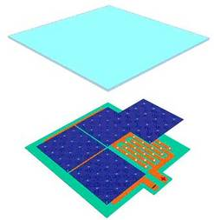

Slide 29
Back‐Contacted Cells
Alternative to cells with a front and rear contact
Lack of grid shading loss (Zero or reduced grid shading)
Simplified module assembly (Co-planar interconnection)

Slide 30
Design categories of back contact cells
Interdigitated Back-Contact (IBC) solar cell
Emitter Wrap-Through (EWT) solar cell
Contact wrap-through solar cell

Slide 31
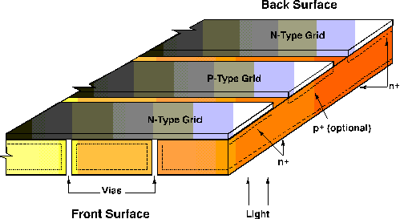
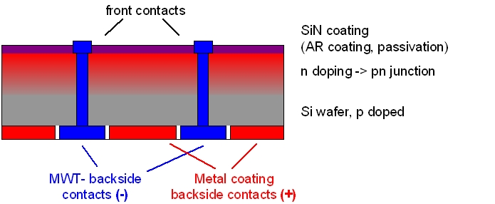
Schematics
IBC
EWT
MWT

Slide 32
Description:
Front contacted cells can have up to 10 % shading loss.
Front contact cell must also use solder connections that run from the front of one cell to the back of the next for series interconnection.
This procedure is more difficult to automate than when using co-planar contacts.
The challenge is to produce a high efficiency cell at low cost using high throughput techniques.

Slide 33
Features:
IBC includes all of those cell designs with back contacts that rely upon carrier collection at a rear surface alone.
The EWT class of cells can accomplish carrier collection at both sides and relies upon current conduction from the front to the back through some sort of perforation in the cell.
The contact wrap-through cell maintains a front contact grid and brings the busbar or its equivalent to the back side through a minimum number of perforations.

Slide 34
Applications:
The IBC cell must be fabricated on material with a long minority carrier diffusion length. The distance from any point in the cell to the junction must be much less than the diffusion length. Excellent front surface passivation is required as well.
The EWT cell is well suited to lower quality silicon materials owing to its ability to collect carriers from both sides. The device does not require close grid spacing since carrier collection is nearly one-dimensional.
The contact wrap-through has a front junction and front grid metal with the busbar or contact pads brought to the back through a small number of holes. This design is a compromise between an all back-contact cell and a conventional front contact cell in that it maintains the interconnection benefits but does not eliminate grid shading.

Slide 35
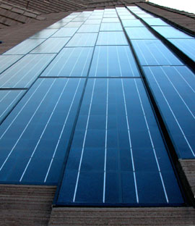
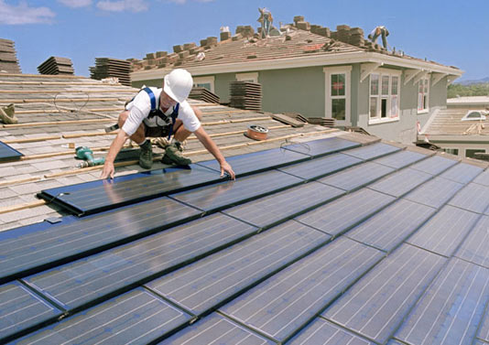
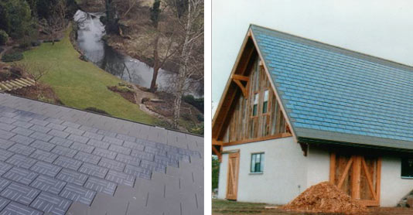

Slide 37
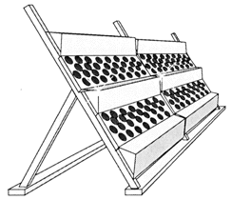

Slide 38
Photon-to-Thermal-to-Electric Energy Conversion
Produce electricity through concentration of solar energy for the production of heat and subsequent conversion into electric current
Parabolic dish
Parabolic trough
Power tower

Slide 40
Parabolic trough

Slide 41
Parabolic trough
Single-axis tracking parabolic mirrors to focus sunlight on thermally efficient receiver tubes that contain a heat transfer fluid (HTF).
The receiver tubes are usually metallic and embedded into an evacuated glass tube that reduces heat losses.
Working fluid (e.g. thermo oil) is heated to ~400oC and pumped through a series of heat exchangers to produce superheated steam which powers a conventional turbine generator to produce electricity.

Slide 42
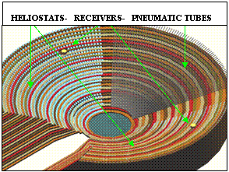
Power tower

Slide 43
Power tower
Hundreds of two-axis tracking heliostats are installed around a tower where they focus sunlight with concentrations ranging from 100 to 10,000 suns.
Absorber is located on the top of the tower and can reach temperatures from 200oC to 3000C.
Hot air or molten salt are usually used to transport the heat from the absorber to a steam generator where superheated steam is produced to drive a turbine and an electrical generator.

Slide 44
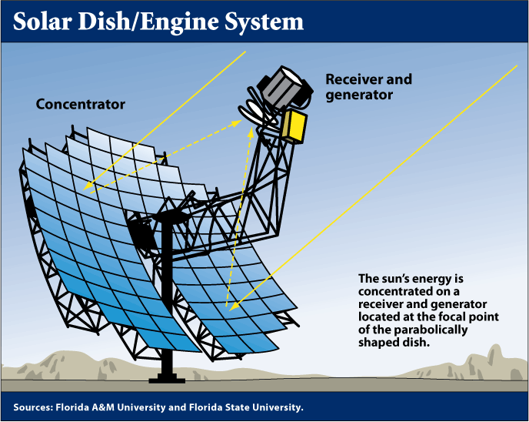
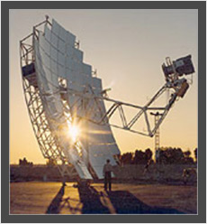
Dish-engine systems

Slide 45
Dish-engine systems
Can be used to generate electricity in the kilowatts range.
A parabolic concave mirror concentrates sunlight; the two-axis tracked mirror must follow the sun with a high degree of accuracy in order to achieve high efficiencies.
At the focus is a receiver which is heated up over 700°C.
The absorbed heat drives a thermal engine which converts the heat into motive energy and drives a generator to produce electricity.

Slide 46
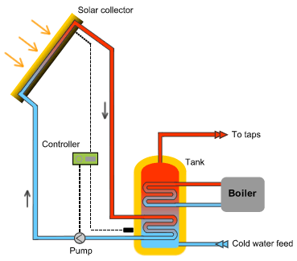
Solar to heat

Slide 47
Photon-to-Chemical Energy Conversion
Photo conversion processes are used for producing a large variety of chemicals with clear energetic and environmental advantages compared to conventional technical processes
Ammonia
Methane
Hydrogen

Slide 48
Photochemical and photoelectrochemical systems
Light-sensitive materials (in aqueous suspension or in the form of bulk electrodes, respectively) for absorbing photon energy and producing electrons with sufficient energy for splitting water.
In thermochemical technologies, concentrated solar flux is used to produce the high-temperatures necessary to drive endothermic reactions.

Slide 51
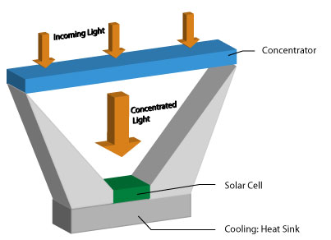
Concentrating Photovoltaics (CPV)
A large area of sunlight is focused onto the solar cell with the help of an optical device.

Slide 52
Advantages:
Requires less photovoltaic material to capture the same sunlight as non-concentrating pv.
Makes the use of high-efficiency but expensive multi-junction cells economically viable due to smaller space requirements.
The optical system comprises standard materials, manufactured in proven processes. Thus, it is less dependant on the immature silicon supply chain. Moreover, optics are less expensive than cells.

Slide 53
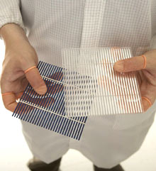

Slide 55
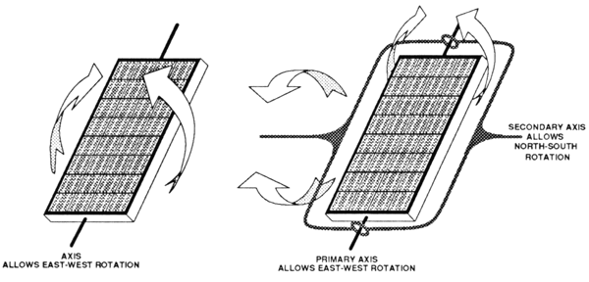

Slide 56
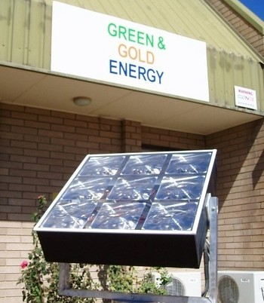

Slide 58
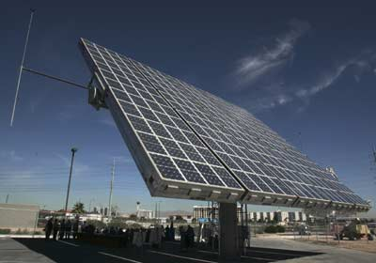

Slide 62
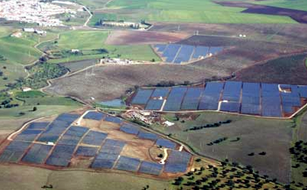
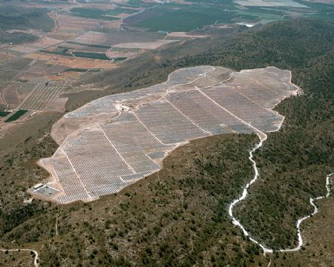
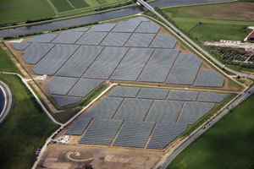

Slide 64
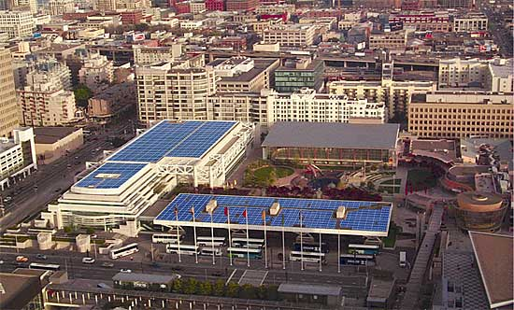
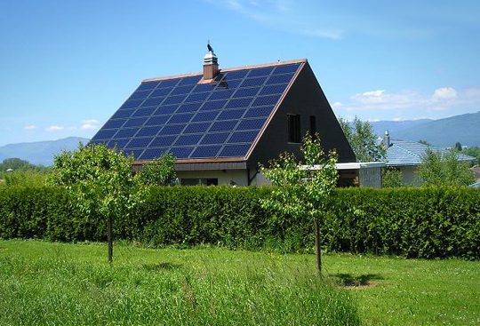

Slide 65
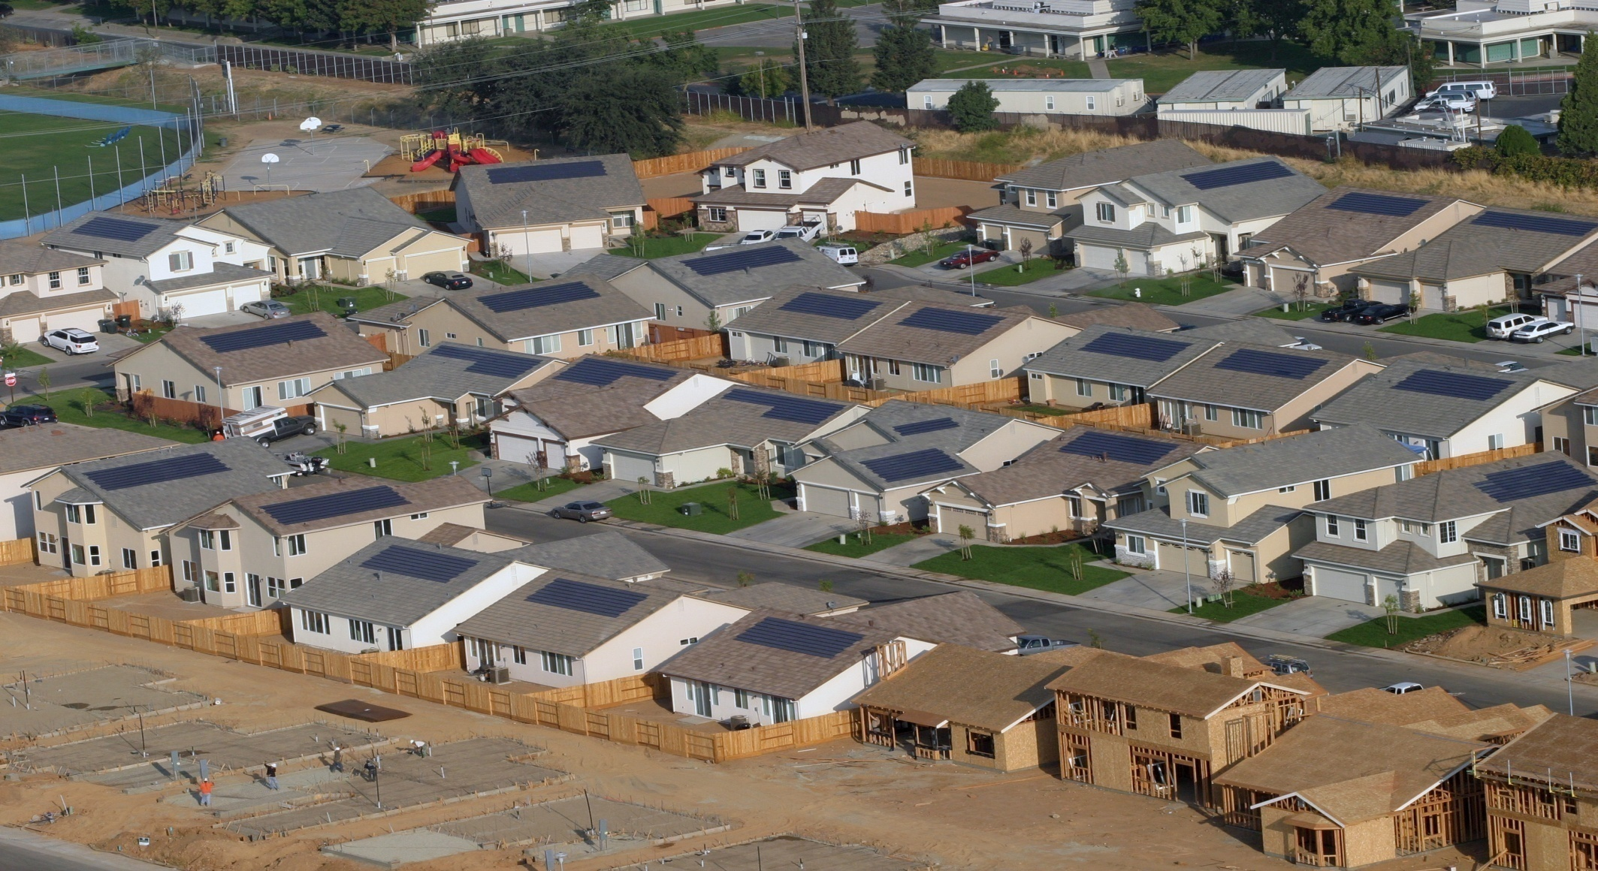

Slide 67
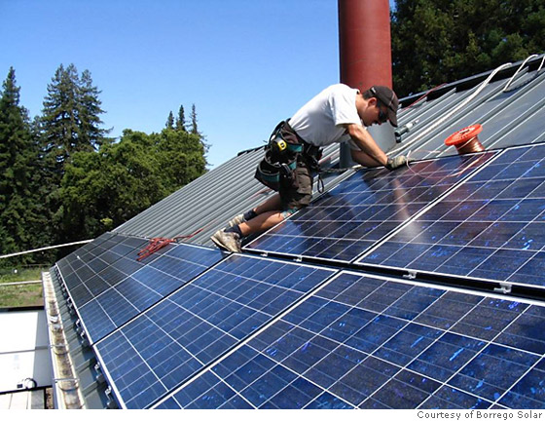

Slide 68
Description:
Though homeowners with solar panels are producing their own power, most are still connected to the electric grid through their utility company.
That’s what makes it possible to sell energy back to the utility.
To be technically “off the grid,” you’d have to have a battery back-up system to store the extra energy you produce.
The batteries are expensive, take up lots of space, and have to be replaced every 5 or 10 years.
So, most people are tied to the grid (grid tie solar).

Slide 69
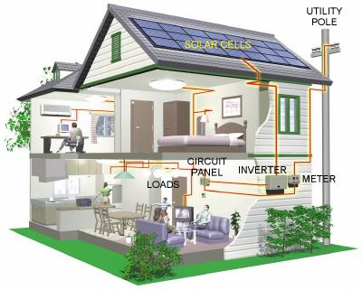

Slide 70
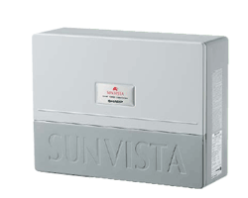
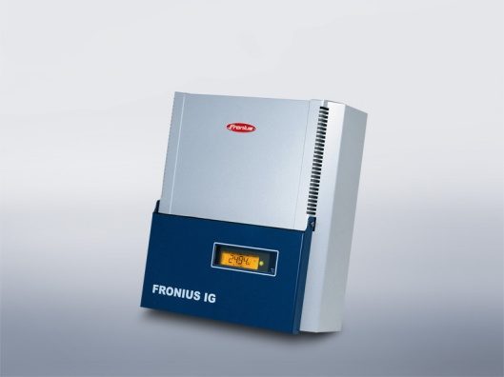
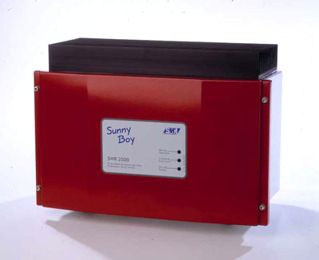
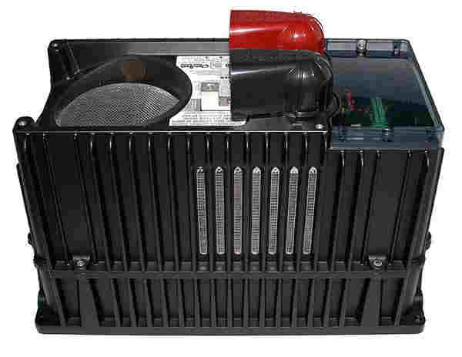

Slide 71
Maximum power point tracking (MPPT)
Technique that solar inverters use to get the maximum possible power from the PV array.
Solar cells have a complex relationship between solar irradiation, temperature and total resistance that produces a non-linear output efficiency known as the I-V curve.
It is the purpose of the MPPT system to sample the output of the cells and apply a resistance (load) to obtain maximum power for any given environmental conditions.
Essentially, this defines the current that the inverter should draw from the PV in order to get the maximum possible power (since power equals voltage times current).

Slide 72
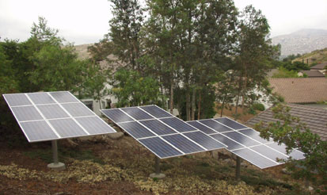

Slide 74
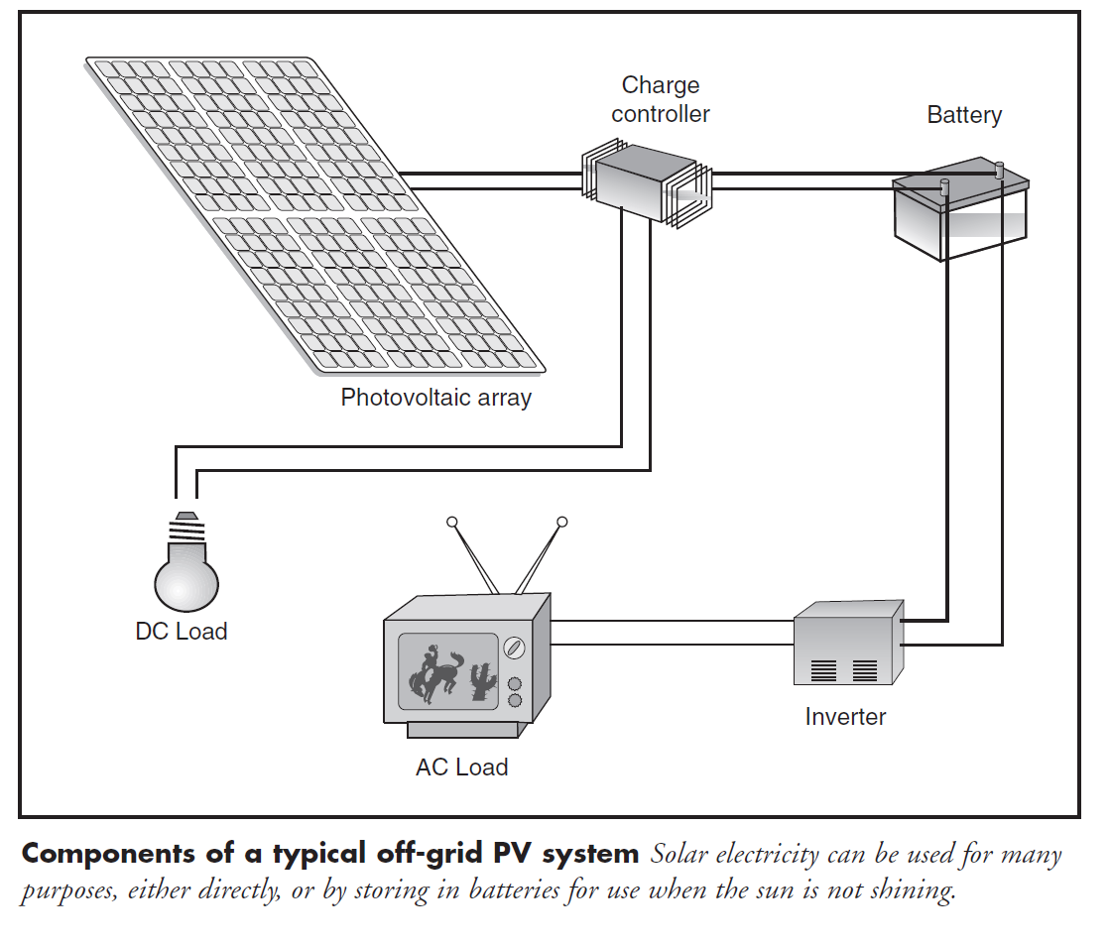

Slide 76
SMES
Superconducting Magnetic Energy Storage (SMES) system.
SMES technology has the potential to bring real power storage characteristic to the utility transmission and distribution systems.

Slide 77
Flywheel energy storage
Works by accelerating a rotor (flywheel) to a very high speed and maintaining the energy in the system as rotational energy.
When energy is extracted from the system, the flywheel's rotational speed is reduced as a consequence of the principle of conservation of energy; adding energy to the system correspondingly results in an increase in the speed of the flywheel.
Most FES systems use electricity to accelerate and decelerate the flywheel, but devices that directly use mechanical energy are being developed.
Advanced FES systems have rotors made of high strength carbon filaments, suspended by magnetic bearings, and spinning at speeds from 20,000 to over 50,000 rpm in a vacuum enclosure. Such flywheels can come up to speed in a matter of minutes — much quicker than some other forms of energy storage.

Slide 78
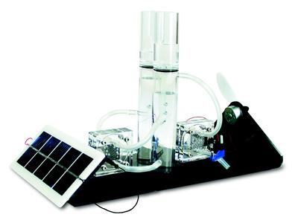
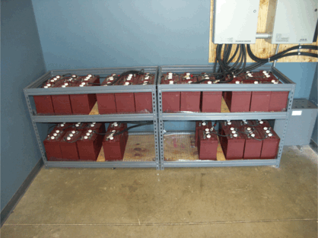

Slide 79
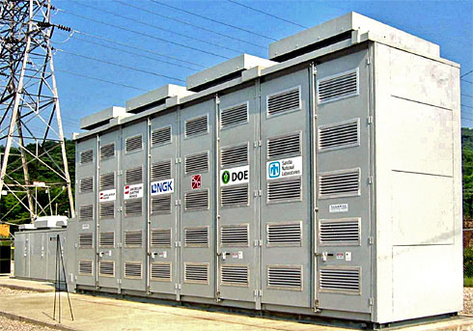

Slide 81
LCA
A LCA analysis considers the environmental burdens caused during the entire life cycle of a product production phase, use phase and End of Life phase [ISO 14040].
This is a suitable tool for analyzing and assessing the environmental impacts which are caused through production, use and disposal or recycling of product systems for specific applications. With this approach the environmental burdens shifting from one life cycle phase to another can be avoided.
As a rule LCA does not produce clear-cut straightforward assertions but gives diverse and complex results. It supports the process of decision-making by making complex issues transparent.
The LCA analysis enables the determination of the environmental performance of thin film PV modules considered in this project. Within the SENSE project the LCA analyses were carried out by applying the LCA software “GaBi 4”, with its background data.

Slide 82
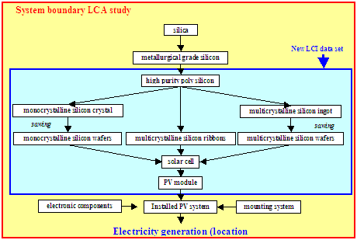

Slide 83
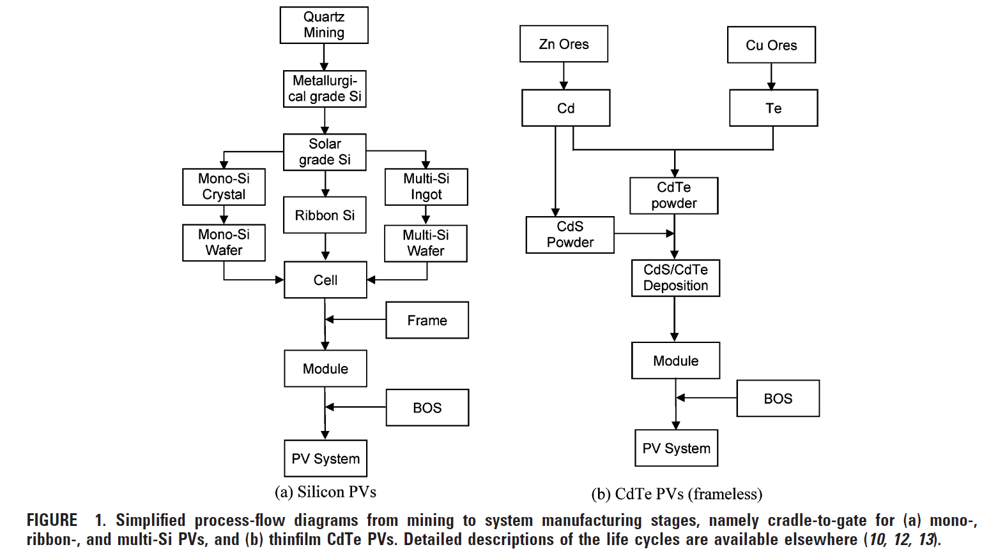

Slide 86
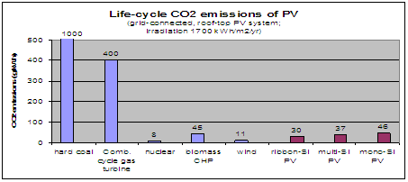
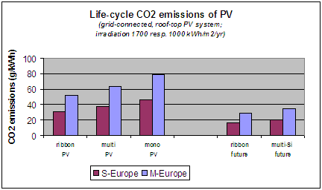

Slide 87
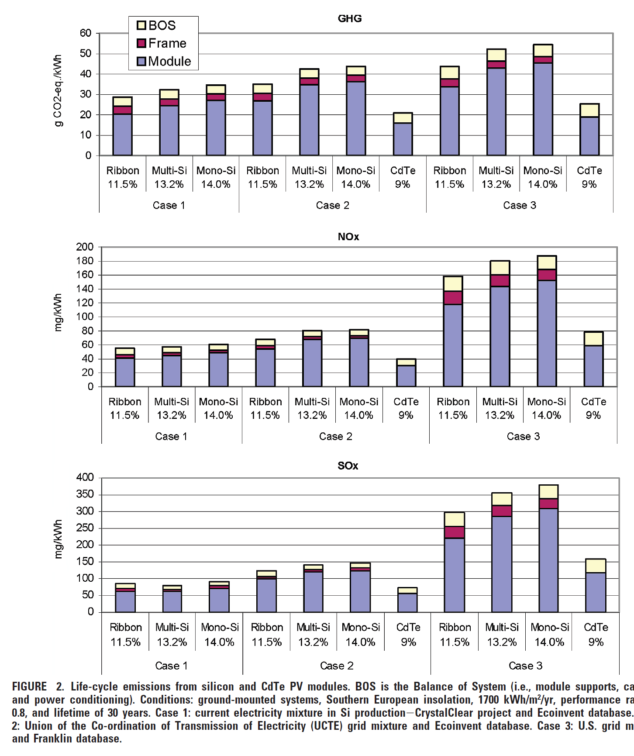

Slide 88
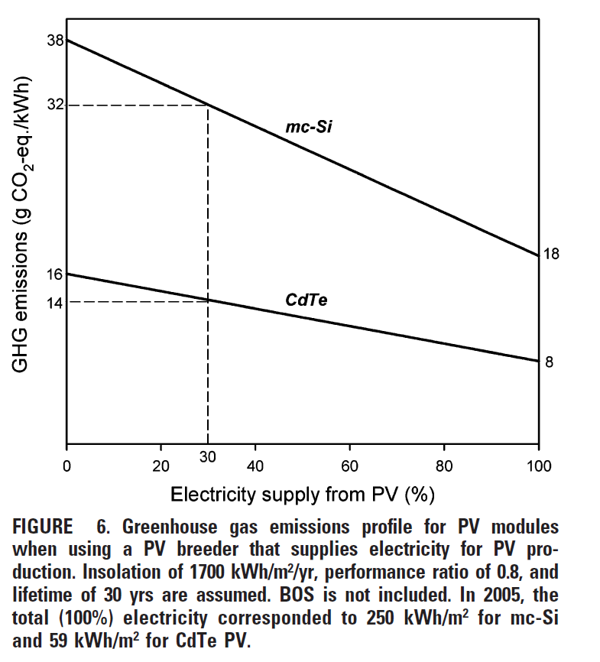

Slide 89
